Slide 1
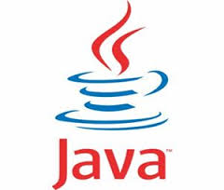
Core Java
J2SE Java XML API

Slide 2
XML Tutorials
XML Stands for Extensive Markup Language.
XML is used to describe Data.
Best part of XML is that it’s a software and hardware independent tool.
XML is used to transport and store Data.
XML has self-describing nature.
XML is easily customized.

